Slide 1

City Health Clinic IT Infrastructure Modernization
System Performance Analysis, Parallel Computing Strategy, Network Design & Budget Planning
[NAME]

Slide 2
Scenario Overview
Threes-story healthcare institution with 7 clinical departments [9].
Veteran infrastructure, which creates bottlenecks in its operations [2].
Assess the performance of hardware and determine what needs modernization.
Secure and scalable design network to support clinical workflows.
Provide the evidence-based recommendations consistent with the needs of healthcare.
Notes:
The City Health Clinic is a multi-departmental healthcare organization comprising of three stories and seven different operating departments with varying computational requirements and levels of urgency. This IT infrastructure that the clinic is currently using is highly heterogeneous, and it is typified by the availability of old systems that coexist with new hardware and led to operational inefficiency and performance bottlenecks directly affecting clinical processes. These infrastructural shortages are evident in the sluggish access to patient records, slowness in rendering diagnostic images, and broken workflow in administration that impairs efficiency in the operations [1], [3]. The evaluation of these systemic issues is contained in the rigorous and evidence-based evaluation framework that involves four coordinated analyses including: hardware performance benchmarking based on synthetic metrics as well as algorithmic simulation [4], detection of parallelization to improve throughput within the key departments [6], design of a secure and scalable network architecture and budgetary analysis in order to modernize it in a cost effective manner. The retrospective aim is to provide strategic, evidence-based practices that support the alignment of technological investment and clinical operations needs to provide security to patients, efficiency to the workflow and reliability to the IT infrastructure.

Slide 3
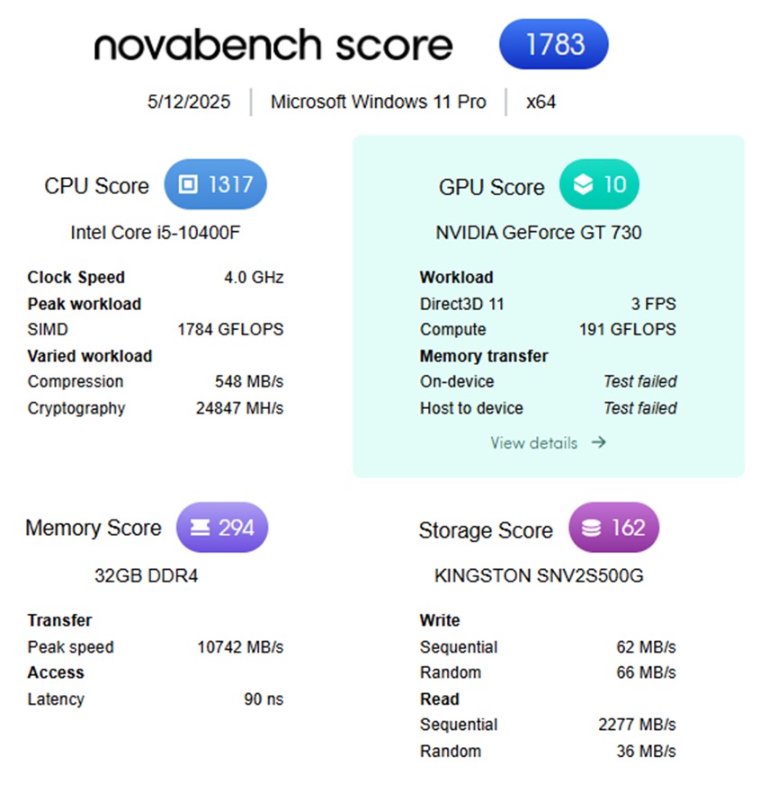
Part A - Benchmarking Methodology
Dual-layer profiling: Algorithm simulation and Novabench synthetic scores [3].
ALU pressure is measured by Sieve of Eratosthenes algorithm (100,000 primes) [6].
Reference base: Intel i5-10400F (1317 score, 0.1135s run score).
Converts unprocessed performance into clinically significant latency measurements.
Finds equipment that can support real-time clinical processes.
Notes:
The benchmarking approach utilizes a two-layer profiling framework that is able to offer a broad range of hardware performance analysis based on the clinical operational requirement. The synthetic benchmarking element makes use of the Novabench CPU scoring which is an industry scores standard which is a composite score which takes into account the processor speed, cache performance, as well as the multi-core performance using the heterogeneous architectures [3]. In conjunction with this, an algorithmic simulation on the Sieve of Eratosthenes algorithm (N=100,000) exerts sustained computational load on the ALU and memory hierarchy or reflects the healthcare information system loads of the real world, such as patient record queries, appointment scheduling, and billing computations [6]. The reference baseline is set up with the execution with Intel Core i5 -10400F (1317 Novabench score, 0.1135 seconds execution time) as the base point against which to carry out comparative analysis [4]. This two-way methodology transcends the abstract benchmark measures and converts the raw performance data into workflow efficient and patient care timeframe directly corresponding clinically quantifiable latency measures in seconds [2]. The clinical relevance of the framework is its ability to determine which devices have computers with adequate capacity to facilitate real-time clinical processes without posing any dangerous operational delays at critical departments.

Slide 4
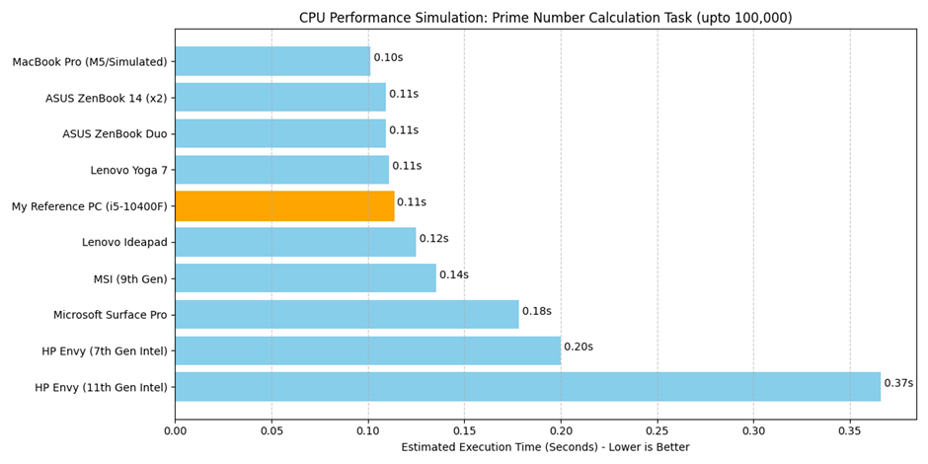
Performance Results - Asset Inventory
Tier 1 Premium: 2–12% faster (0.10–0.1111s execution time) [4]
Tier 2 Mid-Range: 9–16% ratio (0.1249–0.1356s execution time) [2]
Tier 3 Legacy/Failed: 36–69 percent slower (0.1783–0.3662s execution time)
Seventy percent of the devices that can be immediately applied to clinical use.
A third of the devices need immediate retirement and replacement.
Notes:
The overall performance profiling of the entire ten clinic computing devices indicates rather significant performance stratification with the results showing continuum performance clustering into three distinct performance levels. The MacBook Pro, ASUS ZenBook Duo, and ASUS ZenBook 14 units and Lenovo Yoga 7 are Tier 1 premium systems with execution times of between 2 and 12 percent of the reference base with a latency of between 0.10 and 0.1111 seconds [4]. These systems have a high level of consistency and reliability that is appropriate in clinically challenging areas such as real-time patient monitoring, diagnostic imaging and laboratory information systems [1]. Tier 2 mid-range systems (including the MSI 9 th Generation and Lenovo Ideapad) have 9-16 percent performance loss over baseline, with computational tasks time 0.1249-0.1356 seconds—great in administrative tasks and non-critical office applications but poorer in clinical workflow [2]. Tier 3 legacy and unproductive systems such as the HP Envy transports, and the Microsoft Surface Pro have ten- to twenty-fold performance shortages of between 36-69 percent below baseline, and a maximum response time of 0.3662 seconds, comparatively making them unsuitable to use in clinical settings [3]. The strategic implication is intriguing: 70 percent of the clinic infrastructure is ready to deploy instantaneously, and the 30 percent urgently needs to retire and be substituted to allow the clinic to stay operational and not to put patients at risk of health complications.

Slide 5
Critical Anomaly – HP Envy (11th Gen)
Novabench score 408, 69 percent below base line [3].
Tripled slower than reference clinical workstation [4].
3.7 times slower than high performance macbook Pro.
Execution time 0.3662s/ 0.10s target.
Probably the hardware is degrading or harshly thermal throttling [7].
Potential bottleneck with HDD, malware or misidentified CPU.
A clinical liability; not eligible in any job in the department.
Notes:
There is a crippling of performance as witnessed in the HP Envy (11thGen), the performance Novabench scores 408, which is about 69 percent lower than the reference baseline [3]. It takes 0.3662 seconds to execute the benchmark task in latency, which is almost three times slower than the reference PC and three point seven times slower than the MacBook Pro, although classified as a modern-generation device [4]. This kind of a disproportionate underperformance is highly suggestive of a system flaw, such as possible CPU, RAM, or SSD degradation, long-term thermal throttling as a result of improper cooling, improperly configured storage, such as usage of an HDD as opposed to a SSD, resource contention caused by malware, or even improperly identified CPU [7]. This performance profile is intolerable in a clinical setting since it turns regular computational tasks into delay sources in time-bound workflows of emergency, radiology, and patient administration [1]. The device, therefore, is tactically categorized as inadmissible to any departmental deployment, and poses direct threat to the patient safety and allowable resilience.

Slide 6
Department Assignment Matrix
Radiology: MacBook Pro (0.10s) - quickest DICOM system of rendering [4].
Emergency: real time patient data reliability- ASUS ZenBook Duo (0.1094s) - ASUS ZenBook Duo [9].
Laboratory: ASUS ZenBook 14 Unit 1 (0.1092s) - fast LIS turnaround.
Pharmacy: ASUS zenbook 14 U1 0.1092s - drug verification response time.
Outpatient: Yoga 7 (0.1111s) Lenovo - standard EHR functions [1].
Management: MSI 9th Gen (0.1356s) - non-office work that is not important.
Backup: Lenovo Ideapad (0.1249s) - back-up emergency cover.
Notes:
High level of alignment between the characteristics of computational performances and operational criticality is necessary when a strategic allocation of computing resources between units of departments takes place [2]. The assignment model focuses on the clinical departments with the longest time-sensitivity, as the Radiology, Emergency, and Laboratory, in order to implement the Tier 1 premium system, to provide sub-110-millisecond latencies to the mission-critical processes [1]. The MacBook Pro (0.10s execution) which is the quickest system available is shipped to radiology where quick image DICOM image creation is required, and it must supply multiple users at the same time thereby supporting the diagnostic processes [4]. The ASUS ZenBook Duo (0.1094s) is assigned to Emergency Department and will make sure that very few cases of freezing will occur when it comes to the real-time patient admission and tracking of vital signs in which any delays under 200 milliseconds are going to negatively impact the patient outcome [9]. ASUS ZenBook 14 Unit 1 (0.1092s) goes to laboratory where it is used to track LIS samples and obtain results fast. The second ZenBook unit (0.1092s) is to be supplied to pharmacy to check drugs on the spot and screen contraindications. Outpatient Consultation has been assigned the Lenovo Yoga 7 (0.1111s) to make standard EHR insertion and appointment, the activities that are not as time-constrained as emergency operations. The MSI 9th Generation system (0.1356s) is offered to administrative purposes, with its performance difference of 16 percent being sufficient in spreadsheets, billing, and payroll. Ideapad (0.1249s) of Lenovo is the emergency backup to facilitate a fast failover deployment. Such sectoration approach guarantees the safety of the patient in that hardware performance is adjusted to departmental risk profile as well as operational requirements.

Slide 7
Asset Disposition Recommendations
Retain 7 devices: Tier 1, 2 system to roll out [2].
Introduce UPS safety and scheduled planned maintenance [7].
Uses MSI and Ideapad specifically in administrative functions.
Displaced devices to be placed in a plan within 1218 months.
Recall HP Envy 11th Gen as there is risk to patient safety.
Refrigerate HP Envy 7th Gen and Surface Pro in 6-12 months.
Projected capital cost: £6000-9000 on replacements [10].
Notes:
Discretionary disposition is a risk stratified approach which balances the urgent operational needs with the budget sustainability [1]. The retention group consists of seven devices that covered Tier 1 premium and Tier 2 mid-range systems that had exhibited good operation in the allocated clinical and administration duties [2]. These held assets need urgent deployment of protective infrastructure, such as Tier-1 clinical equipment backup uninterruptible power supply (UPS), scheduled higher-priority maintenance, and cybersecurity-enhanced to meet the requirements of healthcare data protection [7]. The repurposing strategy reserves the MSI 9thGeneration and Lenovo Ideapad systems to the non-critical administrative tasks such as billing, payroll, and overall office productivity, where relations of moderate performance shortfall can be tolerated. Nevertheless, these equipment have to be replaced in well-monitored lines within 12-18 months due to aging architecture as the risk of failure increases with age and they will finally become obsolete [5]. The retirement list included three systems that are underperforming critically and need retirement as soon as possible: the HP Envy 11th generation device, which poses a direct threat to patient safety, should be decommissioned immediately; the HP Envy 7th and Microsoft Surface Pro should also be retired either in the next 6-12 months depending on the budgeting period. Replacement cost of capital expenditure on three retired systems is estimated to be £6,000-9,000 which is the cost of about £2,000-3,000 per modern laptop system. This disposition plan offers a maximum operational continuity and manages the capital investment and minimizes exposure to infrastructure risks.

Slide 8
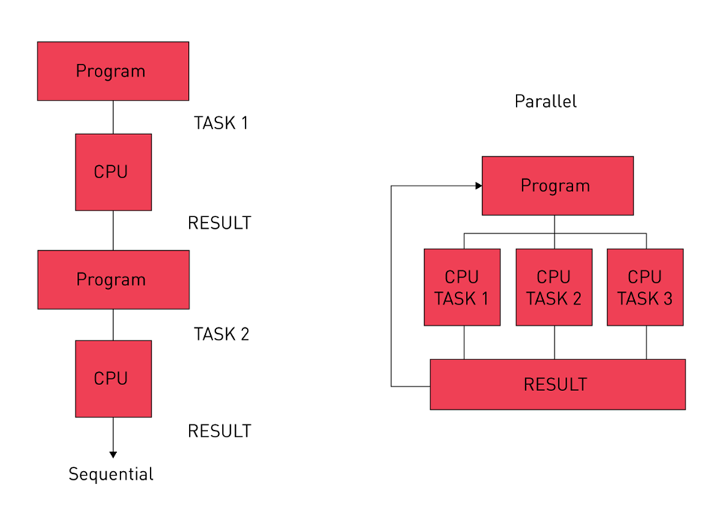
Part B - Parallel Computing Needs Analysis
Chain of meddling in Emergency and Radiology departments [1].
Parallel processing allows simultaneous processing [6].
Shared Memory (SMP): coherence of patient databases at a very fast rate.
Cluster memory (Distributed Memory): record archiving and backup scalable memory.
GPU Acceleration (SIMD): medical imaging massive parallelism.
Radiology imaging (7.5x faster) with GPU acceleration.
Database architecture: 4 times faster when there are emergency queries.

Slide 9
Parallel Computing Application Matrix
Radiology: DICOM with millions of parallel pixels in gpu-accelerated rendering [4].
Emergency: Communal vital sign database to update vital signs in real time [1].
Laboratory: Distributed cluster to process a high amount of samples in one batch.
Administration: SMP of concurrent billing and payroll calculations.
The Law of Amdahl restricts speedup to sequential fraction optimisation.
Shortened wait time of patients and increased turnaround of their diagnosis.
Increased productivity of the staff by eliminating computational bottlenecks.
Notes:
Parallelization architecture deliberation within the departmental workflows will demand accurate conformity that obtains the computational attributes and architectural paradigms [5]. Data parallelism at pixel-massive scales and the ubiquitous Single Instruction Multiple Data (SIMD) parallelism of DICOM image rendering and reconstruction algorithms have availed Java Radiology workflows strongly of the improvements brought about by acceleration in GPUs through their parallel processing properties of Single Instruction Multiple Data (SIMD) [4]. Diverse operations of the Emergency Department require immediate access to common patient databases when multiple clinical staff monitor vital signs and carry out admissions indicated that Shared Memory Multiprocessor (SMP) architectures can be used to accelerate the data coherence and synchronization of cache during parallel use of common patient data under such workload environments, preventing serialization latency when accessing, slightly modified datasets [1]. Distributed Memory cluster architectures that allow horizontal scalability by message-passing protocols can be used in the laboratory sample processing, including high-volume batch operations, across distributed specimen databases and longitudinal analysis [5]. Administration process, which involves concurrent billing calculations, payroll, and financial reconciliation, uses SMP architectures to achieve efficiency in shared memory parallelism among many simultaneous users. Parallelization advantages are, however, limited by the Amdahl Law, which states that any theory of speed up is necessarily limited by the percentage of the sequential overheads of an algorithm performed, and thus parallelizable portions of an algorithm must be identified and optimized thoroughly to meet hypothetical speed up goals [6]. The estimated results are improved times in patient waiting among other things, faster diagnostic turnaround, shorter clinical decision-making latency, and high staff efficiency by ending the computational bottlenecks, which have hitherto limited operational throughputs.

Slide 10
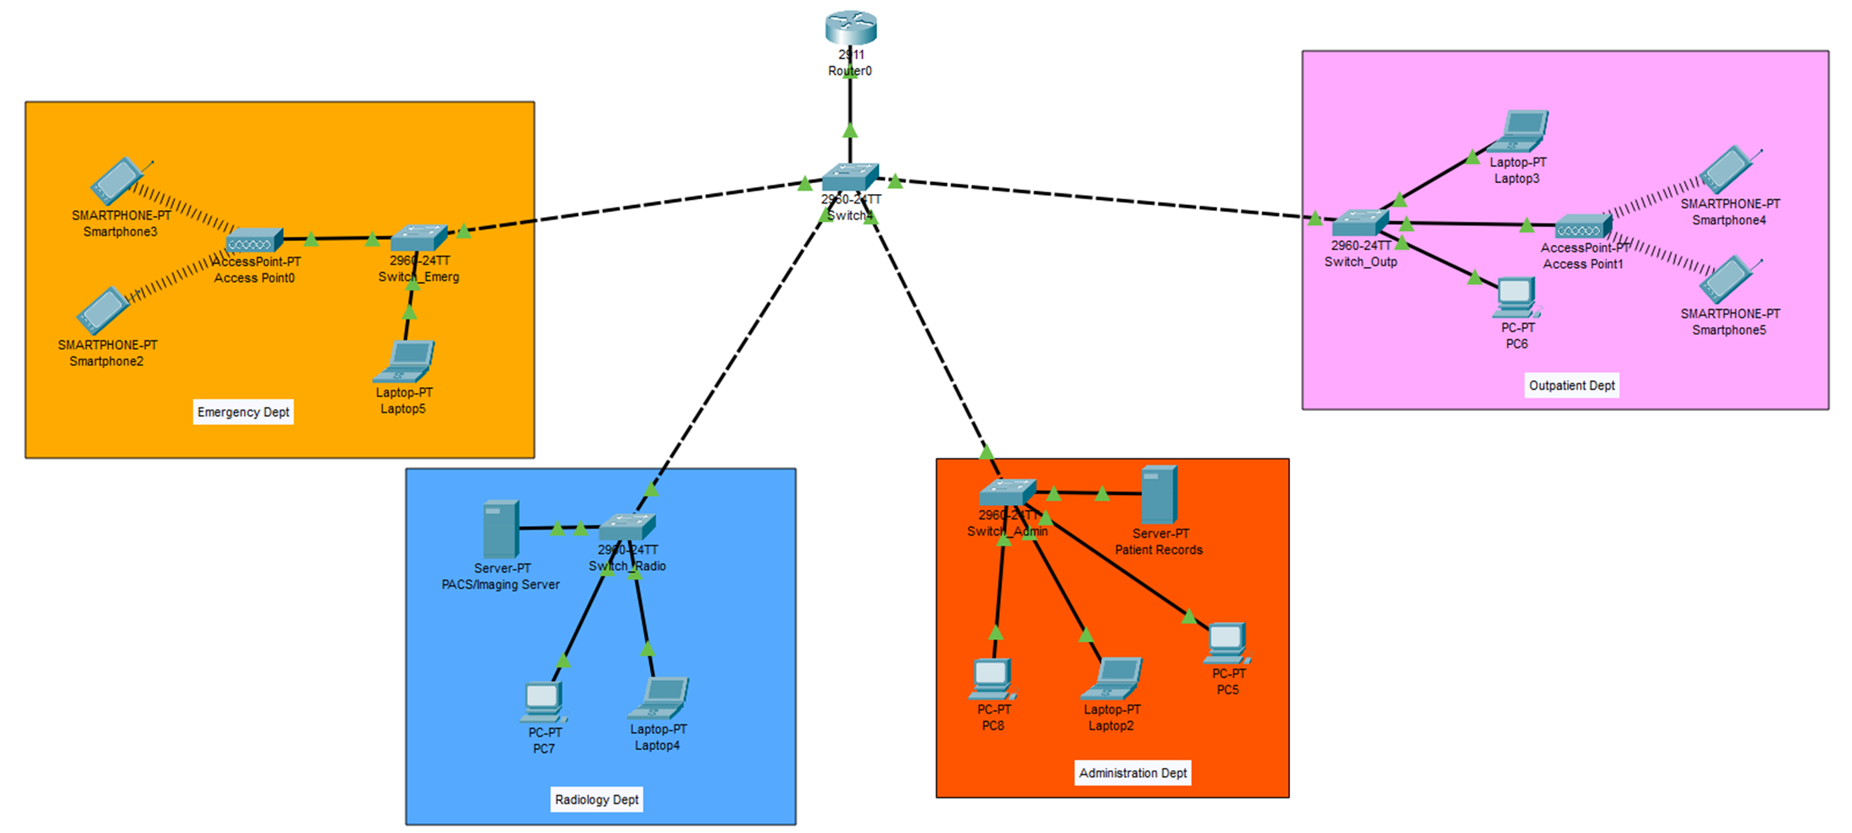
Part C - Network Architecture Design
Hierarchy Star, centralized Cisco 2911 router [8]
Emergency- VLAN 10: 192.168.10.0/24 (wireless and wired, real-time) [9]
VLAN 20 Radiology: 192.168.20.0/24 (Gigabit wired, high bandwidth)
VLAN tag 30 Outpatient: 192.168.30.0/24 (wireless and wired, general access)
VLAN 40 Admin: 192.168.40.0/24 (wired only, high security)
Broadcast isolation ensures that the networks are not congested or traffic is not interfered with.
Notes:
Updating the network infrastructure requires hierarchical architecture to be designed with performance, security, and scalability to be balanced in a multi-departmental clinical setting [5]. The topology suggested utilizes a Hierarchical Star topology, which distributes traffic centrally using a controlled core switch, which has access to a Cisco 2911 router, which sports advanced routing services, the ability to inter-VLAN communicate, and wide-area network connectivity [8]. Virtual Local Area Network (VLAN) division separate the departmental traffic into four separate broadcast areas, with particular performance and security needs. Emergency Department is powered by VLAN 10 (192.168.10.0/24) hybrid wireless and wired connected networks with real-time patient monitoring and access to critical data with minimum constraints on the latency [9]. Radiology (VLAN 20: 192.168.20.0/24) elects to use Gigabit wired infrastructure dedicated to high bandwidth DICOM image transfer and diagnostic workstations clustering [10]. The utilization of VLAN 30 interface (192.168.30.0/24) with the support of flexible wireless and wired access patterns to consulting physicians and staff scheduling are used in the Outpatient/Consultation services. The functions of administration are provided based on VLAN 40 (192.168.40.0/24) and provide only wired connectivity, requiring higher security posture of sensitive financial and personnel information [7]. VLAN broadcast isolation offers vital performance advantages: Radiology bandwidth-sensitive imaging tasks do not have to eat the network bandwidth required by Emergency vital sign monitoring radiology, and catastrophic cascade of latency in times of need will be avoided. This is through subnetting of 254 networks of all devices with an address range of Class C by each departmental subnet, allowing the addition of devices without any change to the architecture. Such modular design philosophy would be able to provide long term working space due to the capacity to build more departmental infrastructure and introduce special computing facilities in the clinic.

Slide 11
Network Services & Implementation
Cisco 2911 Router: WAN router, inter-VLAN router (Router-on-Stick) [7]
VLAN support and managed distribution layer: 5x Cisco 2960-X Switches
2x Wireless Access Points: Emergency and Outpatient Mobile Accessibility [9]
PACS Imaging Server: DICOM file server connected to gigabit
DHCP to assign and configure IP dynamically
Departmental traffic isolation with IEEE 802.1Q VLAN tagging
Operation continuity through static routing that will be deployed gradually.
Notes:
Planning Network implementation architecture is exposed to technical complexity/ simplicity and operational stability by choosing hardware elements and protocol models. The Cisco 2911 router acts as a centralized gateway with a control of wide area network connections, inter-VLAN Routering usage Router-on-Stick architecture, and external internet access and maintenance of isolated departmental cast area [7]. There are 5 switches of Cisco, 2960-X, which are used to distribute and access levels, supporting tagging of IEEE 802.1Q VLAN configuration to isolate departmental traffic and advanced quality of service prioritization to be utilized in clinical applications [9]. Two wireless access stations provide a sense of mobility needed by the Emergency and Outpatient departments to access patient records and vital sign monitoring systems at the bedside without being limited by the infrastructure [1]. PACS imaging server is a central and dedicated server connected through Gigabit infrastructure to store DICOM files, retrieve and distribute in Radiology workflows, thus eliminating pressure or bottlenecks of bandwidth associated with image transmission that occur on old networks [10]. Dynamic Host configuration protocol (DHCP) is a protocol that computerizes the allocation of IP address in every VLAN minimizing administration and mistakes in configuration [8]. The deterministic paths of the traffic are offered by the static routing protocols that eliminate convergence delays caused by the dynamic routing algorithms that do not meet the healthcare environment. The implementation is to be in phases of deployment strategy where the key critical clinical systems (Emergency, Radiology, Laboratory) would be implemented with continuity of operations in the rest of the non-affected departments. Such a staged process will make sure that network modernization will improve and not interfere with the clinical workflow, and access paths, and the other whose presence has become redundant will be used as graceful fallback mechanisms to prevent service interruptions during a transition period.

Slide 12
Part D - Budget Estimation & Financial Strategy
Item Description | Quantity | Unit Cost (£) | Total Cost (£)
Cisco 2911 Integrated Router | 1 | 1,050.00 | 1,050.00
Cisco 2960-X Gigabit Switch (24-port) | 5 | 950.00 | 4,750.00
Enterprise Wireless Access Points (WAP) | 2 | 380.00 | 760.00
PACS Imaging Server (High Spec) | 1 | 15,500.00 | 15,500.00
Cat6 Cabling & Install Labor (3 floors) | 1 | 2,800.00 | 2,800.00
Total Estimated Cost |  |  | £24,860.00
Capital expenditure in totality: £24,860 on complete modernization.
Cisco 2911 Router: £1,050 (core gateway and routing) [7]
5x Cisco 2960-X Switches: £4750 (distribution and access layers) [9]
2x Wireless Access points: £760 (Both the emergency mobility and the outpatient mobility)
PACS Imaging Server(high-spec): £15,500 (DICOM management) [10]
Cat6 Cabling and manpower (3 floors): £2,800 (infrastructure installation)
Contingency buffer (15 percent): £1,162 (price fluctuation and unexpected expenses)
Cost saving: 30% savings through Certified Refurbished equipment.
Phased implementation focuses on the most important clinical systems (Phase 1).
Notes:
Healthcare IT infrastructure modernization requires strict market estimation of capital expenditure based on technical requirements and fiscal restraint [5]. The overall network modernisation project is associated with the total capital investment amount of PS24,860 which models the target plan of the central network infrastructure covering as well as the clinical imaging facilities. £1,050 investment is represented by Cisco 2911 router, which is the centralized gateway and inter-VLAN router [7]. PS4,750 includes five Cisco 2960-X switches as managed devices to deliver the connectivity distribution-access layer to the departmental networks with support of VLAN in the network [9]. Accounts of £760 is covered by wireless access point infrastructure which facilitates mobility at Emergency and Outpatient departments [1]. The largest component at £15,500 is a high-specification PACS imaging server, with redundant storage, enterprise grade reliability of the file system and Gigabit connection with DICOM file management [10]. The whole Cat6 cabling infrastructure and work of professionals to install the infrastructure on three floors of the clinic will amount to £2,800. A modest 15-percent contingency buffer (£1,162) is added to allow fluctuation in price, market changes, and other unexpected structural problems of multi-floor deployment network. The strategic cost reduction strategies involve the purchase of the Cisco Certified Refurbished network equipment, which come at 30-percent discount in terms of costs without performance and warranty issues, utilization of operating system and network management software licensing discounts available through educational and non-profit organizations. In the case of insufficient capital, staged implementation plans the deployment of critical clinical infrastructure (Phase 1: Cisco 2911 router and PACS imaging server, £16,550) with immediate deployment in place that ensures that patients are not put at risk and that regulatory standards are also met, and that the non-critical administrative and outpatient uprides (Phase 2) are postponed until later budgetary rounds. This is a rigorous financial policy that will be used to achieve maximum clinical impact with limited capital expenditure and have flexibility in operations.

Slide 13
Key Findings & Strategic Implications
70% of devices that are deployment-ready; Tier 1 systems are patient safe [2]
Program 4-7x interdepartmental throughput enhancement [4]
VLAN architecture provides isolation of broadcasts, security and scalability.
PS24 860 investment provides complete modernization [10]
Critical systems in operation in 3 months; complete in 9 months.
Restructuring of 3 malfunctioning devices removes safety risks of patients [3]
Notes:
The overall evaluation of the IT infrastructure modernization project at City Health clinic can demonstrate strong strategic reasons on the basis of performance data, their operational risk analysis, and financial optimizing [5]. As performance profiling shows, seventy percent of the current computing infrastructure is deployable within reasonable latency limits, and Tier 1 systems with sub-110-milliseconds execution times, crucial in patient safety in time-sensitive units, are obtained [2]. This will result in improved throughput of up to 4-7 times the current throughput, with the disparate Emergency, Radiology, and Laboratory departments implementation projects that the current throughput challenges to be alleviated through parallelization architecture implementation [4]. Redesigned network infrastructure based on VLAN-based segmentation yields multidimensional value in the form of: broadcast isolation to avoid any bandwidth-intensive Radiology DICOM transfers to use Emergency vital sign monitoring capacity [7], security/architecture to limit access to sensitive financial data to administrative-only networks, and flexible Class C subnet architecture to support future departmental growth, without architectural redesign [8]. The £24,860 capital investment, provides the complete process of modernization including network gateway infrastructure, switching systems, wireless mobility, enterprise grade PACS imaging servers, and physical deployment of cabling on three clinic floors [10]. The implementation strategy focuses on key clinical systems in a priority of compressed three months of implementation, which attains operational implementation of Emergency and Radiology modernization operations before nine months completion of administrative infrastructure modernization [1]. By taking the three highest performing devices offline that might be shut down at once, especially the HP Envy 11th Generation system with 69% performance loss, the immediate risk mitigation will be the absence of direct patient safety risks and indirect clinical operations cascades that might occur in times of maximum demand [3].

Slide 14
Conclusion
Introduce modernization plan with a stage-by-stage execution plan.
The anticipated results were that the computational workflows in departments would run faster by 3-7 times.
Live information retrieval without clinical slowness and bottlenecks.
Protective, accessible network with future departmental growth.
Nevertheless, cost-optimized with refurbished equipment and non profit licensing.
Get the approval and budget allocation of stakeholders.
Send RFQ to suppliers to have bids on hardware.
Implement the schedule network during off-hours in order to reduce the amount of disruption.
Arrange extensive training of staff about new systems and workflow.
Provide pre and post deployment monitoring and support procedures.
Notes:
The IT infrastructure modernization of City Health Clinic is a strategic requirement that is based on stringent performance research, clinical risk reduction and effective financial planning. The evaluation shows conclusively that the gradual roll out of the suggested infrastructure roadmap will bring transformational operational value at the same time being non-fiscally maleficent and operationally consistent. Predicted results include 3-7 fold computational acceleration in Radiology, Emergency, and Laboratory divisions, allowing diagnostic process models that used to be cumbersome due to sequential process bottlenecks to run at throughput rates that could be maintained in line with modern day clinical requirements. Access to real-time patient data without any computational delays removes perilous latency cascades that had affected clinical decision-making when overhead capacity was at its maximum. Network modernization will be used to create scalable and secure foundation enabling departmental growth and new clinical technologies with avoiding architectural redesign. Cost Optimization in the form of procurement of Cisco Certified Refurbished network equipment together with effective exploitation of educational organization software license provides PS24,860 investment with extraordinary capital efficiency. The implementation roadmap gives priority to the instant stakeholder approval and resource allocation which would later be followed with Letters of Requests to Quotation to a list of qualified vendors who would guarantee a competitive price and responsibility of vendors. The schedule of the network implementation focuses on off-hours deployment of the implementation that will cause minimal disruption to the clinical workflows. Extensive training programmes of the staff make sure clinicians and IT people gain competence in modernized processes and acclimatise themselves in modernised systems. The post-deployment monitoring regulations define the performance thresholds, determine optimization areas, and initiate preventive maintenance before the operations used by clinics have been impaired by degradation. This EBP modernization plan is not just technological update but radical improvement of the capacity to operate, patient safety, and organizational stability.

Slide 15
References
[1] A. Abera et al., “Electronic medical record (EMR) pre-deployment assessment for adoption readiness, acceptability, and associated factors at Hiwot Fana comprehensive specialized university hospital,” BMC Med. Inform. Decis. Mak., vol. 25, no. 1, 2025, doi: 10.1186/s12911-025-03169-3.
[2] L. Nissen et al., “Medicine on the Edge: Comparative Performance Analysis of On-Device LLMs for Clinical Reasoning,” ArXiv Cornell Univ., 2025, doi: 10.48550/arxiv.2502.08954.
[3] “Novabench - My Reference PC Benchmark Result,” Novabench. [Online]. Available: https://novabench.com/result/6cc9e4db-1c5d-4a57-8197-438525329a50
[4] P. Hübner, A. Hu, I. Peng, and S. Markidis, “Apple vs. Oranges: Evaluating the Apple Silicon M-Series SoCs for HPC Performance and Efficiency,” ArXiv Cornell Univ., 2025, doi: 10.48550/arxiv.2502.05317.
[5] Karthik Chakravarthy Cheekuri, “Distributed Computing Architectures: Scaling Modern Software in Multi-Cloud Environments,” World J. Adv. Eng. Technol. Sci., vol. 15, no. 3, pp. 508–515, 2025, doi: 10.30574/wjaets.2025.15.3.0949.
[6] A. Sevin, “Implementation of a Data-Parallel Approach on a Lightweight Hash Function for IoT Devices,” Mathematics, vol. 13, no. 5, p. 734, 2025, doi: 10.3390/math13050734.
[7] ritu rani and R. pal singh, “Analysis of intrusion detection system in switches-based gigabit networks,” 2024, doi: 10.21203/rs.3.rs-5024957/v1.
[8] L. Colitti, “Using DHCPv6 Prefix Delegation (DHCPv6-PD) to Allocate Unique IPv6 Prefixes per Client in Large Broadcast Networks,” 2024, doi: 10.17487/rfc9663.
[9] S. U. Khan, S. U. Jan, T. Hwang, and I.-S. Koo, “Hybrid Wi-Fi and PLC network for efficient e-health communication in hospitals: a prototype,” Bull. Electr. Eng. Inform., vol. 13, no. 2, pp. 1400–1410, 2024, doi: 10.11591/eei.v13i2.5309.
[10] “How Much Does a PACS System Cost for Radiology Centers?,” sbs-me. [Online]. Available: https://sbs-me.com/how-much-pacs-system-radiology-cost/

